Slide 1
Computer Graphics

Slide 2
Computer Graphics
A field related to the generation of graphics using computers
- It includes the creation, storage and manipulation of images of objects.
Until early 1980’s it was a small specialized field
Hardware was expensive
Graphics based application programs that were easy to use and cost effective were few
PCs with built in raster graphics displays such as the Xerox Star, Apple Macintosh and the IBM PC – popularized the use of bitmap graphics for user computer interaction.
A bitmap is a 1 and 0s representation of the rectangular array of points on the screen.
- Each point is called a pixel, short for “picture elements” or “pel”.

Slide 3
Computer Graphics
Once the bitmap graphics became affordable an explosion of easy to use, inexpensive graphics based user interfaces allowed millions of new users to control simple low cost application programs such as word processors, spreadsheets and drawing programs
The concept of a “desktop” now became popular metaphor for organizing screen space.
Even people who do not use computers encounter computer graphics in TV commercials and as cinematic special effects.

Slide 4
Computer Graphics
Computer graphics is an integral part of all computer user interfaces, and is indispensable for visualizing 2D, 3D objects in almost all areas such as education , science , engineering, medicine, commerce the military advertizing and entertainment.
The theme is that learning how to program and use computers now includes learning how to use simple 2D graphics

Slide 5
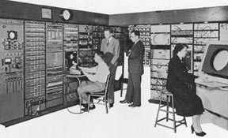
Early History of Computer Graphics
Crude plotting of hardcopy devices such as teletypes and line printers dates from the early days of computing
The whirlwind computer developed in 1950 at the Massachusetts Institute of Technology (MIT) had computer driven CRT displays for output.

Slide 6
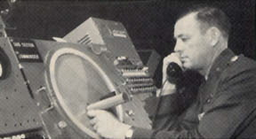
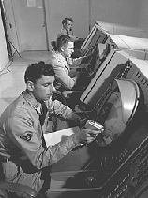
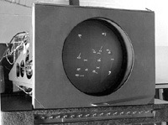
Early History of Computer Graphics
SAGE air-defense system developed in the middle 1950s was the first to use command and control CRT display consoles on which operators identified targets with light pens
(hand held pointing devices that sense light emitted by objects on the screen)
The General Motors DAC system for automobile design and the Itek-Digitek system for lens design

Slide 7
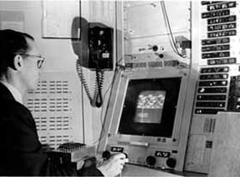
Early History of Computer Graphics
Later on Sketchpad system by Ivan Sutherland came in light.
- The beginning of modern interactive graphics.
- Keyboard and light pen used for pointing, making choices drawing.
Prospects of the use of (CAD) and (CAM) in computer, automobile, and aerospace manufacturing Drafting and Drawing activities.
By the mid 60s, a number of commercial products using these systems had appeared

Slide 8
Early History
At that time only the most technology intensive organizations could use the interactive computer graphics where as others used punch cards, a non-interactive system .
Reasons:
The high cost of graphics hardware – at a time when automobiles cost a few thousand dollars, computers cost several millions of dollars, and the first commercial computer displays cost more than a hundred thousand dollars
The need for large scale expensive computing resources to support massive design database
The difficulty of writing large interactive programs using batch oriented FORTRAN programming

Slide 9
Early History of Computer Graphics
One of a kind , non-portable software, typically written for a particular manufacturer’s display devices.
( When software is non-portable, moving to new display devices necessitates expensive and time consuming rewriting of working programs)
Thus interactive computer graphics had a limited use when it started in the early sixties but it became very common once the Apple Macintosh and IBM PC appeared in the market with affordable cost

Slide 10
Uses of Computer Graphics
Office automation and electronic publishing
User interfaces
Plotting
Art and commerce
Cartography
Computer aided drafting and design
Scientific and business visualization
Entertainment
Simulation
Medical
Internet

Slide 11
User Interface.
Most applications have user interfaces that rely on desktop window systems to manage multiple simultaneous activities, and on point-and-click facilities to allow user to select menu items, icons, and objects on the screen.
These activities fall under computer graphics.
For example Word processor, Spreadsheet, and desktop-publishing programs are the typical examples where user-interface techniques are implemented.

Slide 12
Plotting
Plotting 2D, 3D graphics of mathematical, physical and economics functions use computer graphics extensively.
The histogram, bar, and pi-chart; the task-scheduling charts are the most commonly used plotting.
These all are used to present meaningful and concisely the trends and patterns of complex data.

Slide 13
Office automation and electronics publishing
Office automation and electronics publishing can produce both traditional print (hardcopy) documents and electronics (softcopy) documents that contain text, tables, graphs, and other form of drawn or scanned in graphics.

Slide 14
Computer aided drafting and design
One of the major uses of computer graphics is to design component and systems of mechanical, electrical, electrochemical, and electronics devices, including structure such as building, automobile bodies, airplane and ship hull, very large-scale integrated (VLSI) chips, optical systems, and computer networks.

Slide 15
Scientific and business visualization
Generating computer graphics for scientific, engineering, and medical data set is termed as scientific visualization whereas business visualization is related with non scientific data set such as those obtained in economics.
Visualization makes easier to understand the trends and patterns inherent in the huge amount of data sets.

Slide 16
Simulation
Simulation is the imitation of the conditions like those, which is encountered in real life.
Simulation thus helps to learn or feel the conditions; one might have to face in near future without being danger at the beginning of the course.
For example, astronauts can exercise the feeling of weightlessness in a simulator.
Similarly a pilot training can be conducted in a flight simulator and so on.

Slide 17
Entertainment
Disney movies such as Lion Kings and The Beauty and the Best, and other scientific movies like Star Trek, are the best examples of the application of computer graphics in the field of entertainment.
Computer and video games such as Fifa, Superbike, and Moto GP are few to name where computer graphics is used extensively.

Slide 18
Art and commerce
Here computer graphics is used to produce picture that express a message and attract attention such as a new model of a car.
These pictures are frequently seen at transportation terminals, supermarkets, hotels, etc. the slide production of commercial, scientific, or educational presentations is another cost effective use of computer graphics.
One of such graphics package is Power-point.

Slide 19
Cartography
Cartography is a subject, which deals with making map and charts.
Computer graphics is used to produce both accurate and schematic representations of geographical and other natural phenomenon from measurement data.
Example includes geographic maps, oceanographic charts, weather maps, contour maps and population-density maps.

Slide 20
Medical
Computer Graphics is now widely used in medical sector.
Computer Graphics become a powerful tool of diagnosis and treatment in the hands of doctors.
Tomography is a technique of x-ray photography that allows cross sectional views of physiological systems to be displayed.
CT scan technology is another example where computer graphics is widely used.

Slide 21
Internet
Internet is a computer network system where computer graphics is used at maximum.
Internet is most popular means of communication.
Internet would be nothing without graphics.
There is a tremendous verity of multimedia content available on the web.
Without computer graphics on the web it would be just like a notepad file which contains only text no images.

Slide 22
Image Processing
Computer graphics is used to create a picture while image processing is used to modify or interpret existing pictures such as photographs and TV Scans.
Two principle use in image processing are
improving picture quality
machine perception of visual information as used in robotics

Slide 23
Image Processing
In image processing photograph is first digitize into an image file and then the rearrangement picture parts, to enhance color separations or to improve the quality of shading.
In medical application image processing is used to enhance the photograph for example “tomography” and simulation operation.
Tomography is a technique of X-ray photography that allows cross sectional views of physiology system to be displayed.

Slide 24
Advantages of Computer Graphics
It provides tools for producing pictures not only of concrete real world objects but also of abstract, synthetic objects such as mathematical surface in 4D, 6D, etc.
It has the ability to show moving pictures and thus it is possible to produce animations with computer graphics.
With computer graphics user can also control the animation speed, portion of the view, the geometric relationship the object in the scene to one another, the amount of detail shown and on.

Slide 25
Advantages of Computer Graphics
The Computer graphics provides tool called motion dynamics.
With the recent development of digital signal processing (DSP) and audio synthesis chip the interactive graphics can now provide audio feedback along with the graphical feedback to make the simulated environment even more realistic.

Slide 26
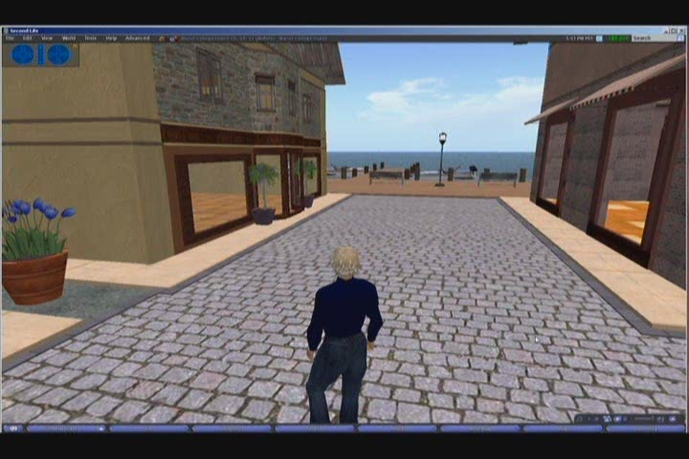

Slide 27
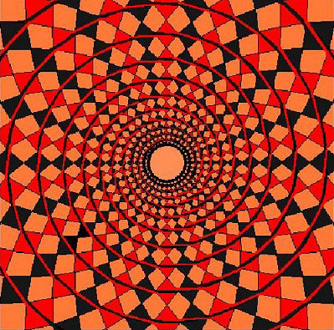

Slide 28


Slide 29
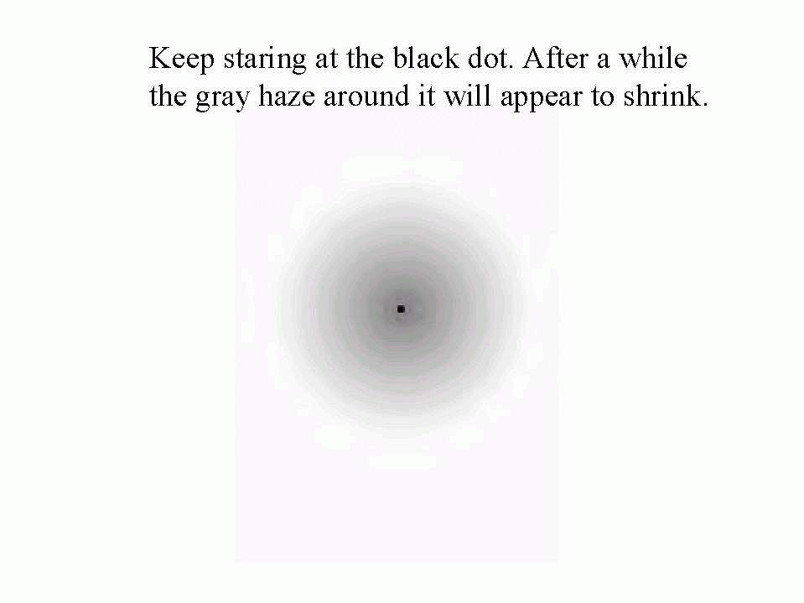

Slide 30
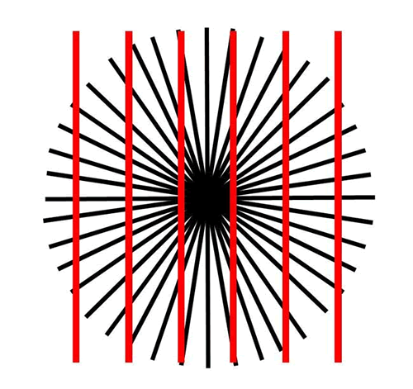

Slide 31
Chapter 2
Hardware Concepts:
Since a computer is an electronic machine, so without any input to a computer it doesn’t work anything.
Keyboard
Mouse
Light pen
Touch screen, and
Tablet

Slide 32
Keyboard
Mouse
Mechanical
Optical
Light pen
Touch Panel/screen
Optical
Sonic
Electrical
Tablet
Electrical
Sonic
Resistive
Joystick

